Slide 1


GNR638 COURSE PROJECT
Guide : Prof. Biplab Banerjee
Denoising, Inpainting and Super Resolution of Images
IJCV 2020 PAPER
GROUP
PARAG BAJAJ | 190100088
SAI ANEESH SURYADEVARA | 190100125
TAMOGHNO KANDAR | 190100126
SANKET GHYAR | 190110023
ANSH THAMKE | 190100020
ARPIT TIWARI | 190110011
Project Code link

Slide 2

Problem Statement
01

Slide 3

INTRODUCTION
Reconstructing High-Resolution (HR) image from its corresponding Low-Resolution (LR) image is known as Super-Resolution (SR)
The goal of inpainting is to fill the missing pixels. It can be seen as creating or modifying pixels which also includes tasks like deblurring, text removal, artifact removal, etc
Image Denoising is the process of removing noise from the Images. The noise present in the images may be caused by various intrinsic or extrinsic conditions which are practically hard to deal with

Slide 4
PROBLEM STATEMENT
To show that a randomly-initialized neural network can be used as a handcrafted prior with excellent results in standard inverse problems such as denoising, super-resolution, and inpainting
This work also aims to bridge the gap between two very popular families of image restoration methods: learning-based methods using deep convolutional networks and learning-free methods based on handcrafted image priors such as self-similarity

Slide 5
Motivation
02

Slide 6
WHY A NEW METHOD?
The aim of this work is to show that a great deal of image statistics can be captured by the structure of generator ConvNets, independent of learning
IDEA:
Fit a generator network to a single degraded image
Network weights serve as a parametrization of the restored image
Weights are randomly initialized and fitted to a specific degraded image
The only information used to perform reconstruction is contained in the single degraded input image and the handcrafted structure of the network used for reconstruction
Notes:
In this formulation, no aspect of the network is learned from data
We want to illustrate the power of the image prior implicitly captured by the network structure.

Slide 7
WHY A NEW METHOD?
We show that this very simple formulation is very competitive for standard image processing problems such as denoising, inpainting, super-resolution, and detail enhancement.
Notes:
In this formulation, no aspect of the network is learned from data
We want to illustrate the power of the image prior implicitly captured by the network structure.

Slide 8
Proposed Solution
03

Slide 9
PROPOSED METHOD
Deep networks are applied to image generation by learning generator/decoder networks x = f_{θ}(z) that map a random code vector z to an image x.
Our aim is to investigate the prior implicitly captured by the choice of a particular generator network structure, before any of its parameters are learned
Parametrization x = f_{θ}(z) of an image x ∈ R^{3✕H✕W}
Most of our experiments are performed using a U-Net type “hourglass” architecture with skip-connections, where z and x have the same spatial size.

Slide 10
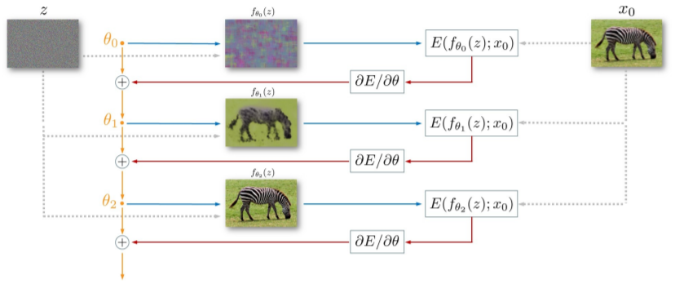
PROPOSED METHOD

Slide 11
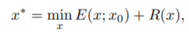
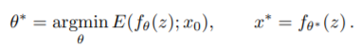
PROPOSED METHOD
To demonstrate the power of this parametrization, we consider inverse tasks such as denoising, super-resolution and inpainting.
where E(x; x0) is a task-dependent data term, x0 the noisy/low-resolution/occluded image, and R(x) a regulariser
In this work, we replace the regularizer R(x) with the implicit prior captured by the neural network, as follows:

Slide 12
Experimental Details
04
Dataset, Implementation
And results

Slide 13
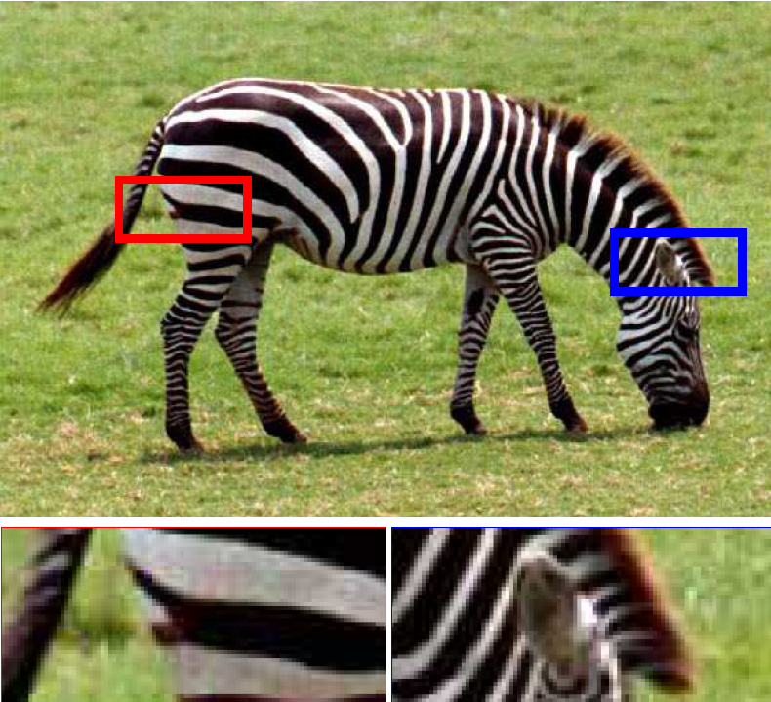
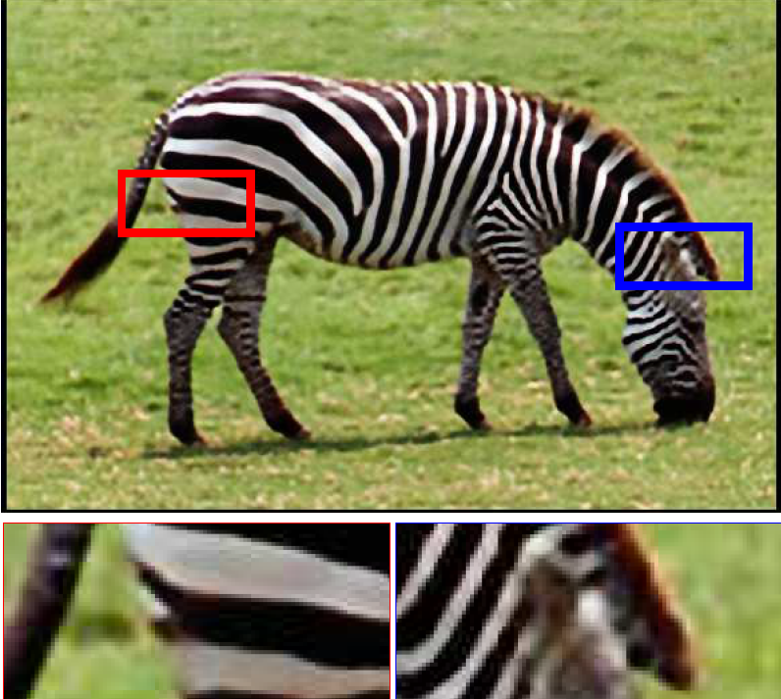
Super-Resolution using the Deep Image Prior
Ground Truth (Low Resolution Image SR: High Resolution Image after Using Deep Prior
Of zebra): The only used image

Slide 14
PSNR Comparisons with other methods
Implementation of SR
Downsampling is done using operator d() that resizes an image by a factor t given by
d(·) : R(3×tH×tW) → R(3×H×W)
Next, Regularizing the problem (given in method section) is done by considering the re-parametrization x = fθ(z) and optimizing the resulting energy w.r.t. θ. Optimization which uses gradient descent
1] 4X Super-Resolution
IMAGE | DEEP PRIOR | BEST
LR Zebra | 25.71 | 26.98 (LapSRN)
2] 8X Super-Resolution
IMAGE | DEEP PRIOR | BEST
LR Zebra | 20.62 | 20.62 (DEEP PRIOR)

Slide 15
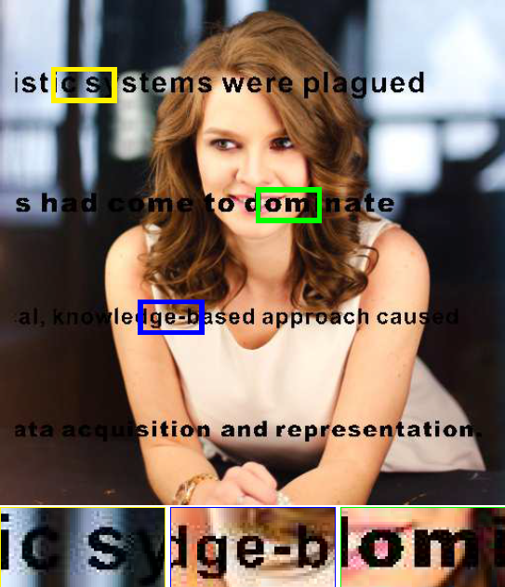
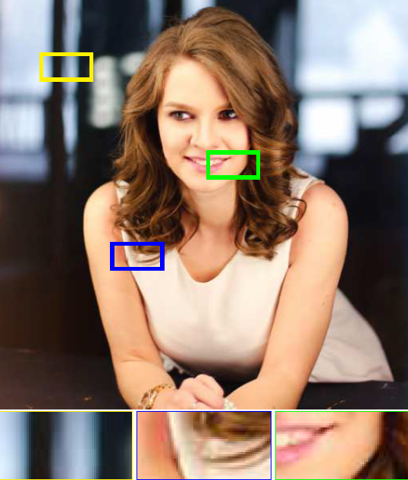
2. Inpainting using the Deep Image Prior
The Only Corrupted Image(Of a person) Image after Inpainting using Deep Prior

Slide 16
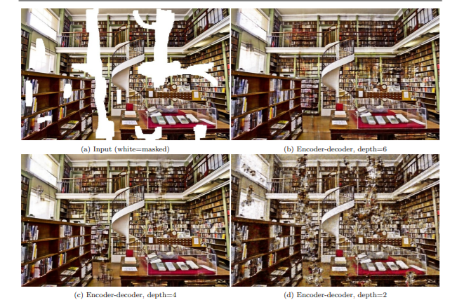
PSNR Comparison of Deep prior to methods based on Convolutional sparse coding
IMAGE | DEEP PRIOR | Papyan et .al
BARBARA | 32.22 | 28.14
Fig. Inpainting Results using network with different depths.
After comparing with different architectures, Deeper random networks having skip connections is highly detrimental for deep prior

Slide 17
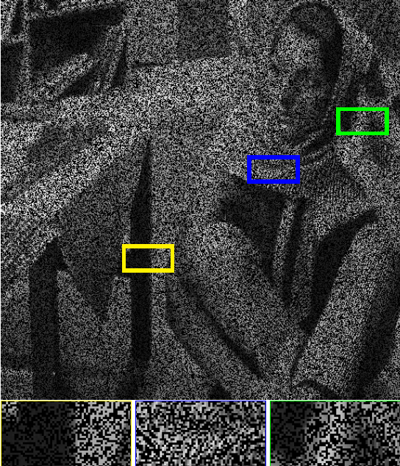
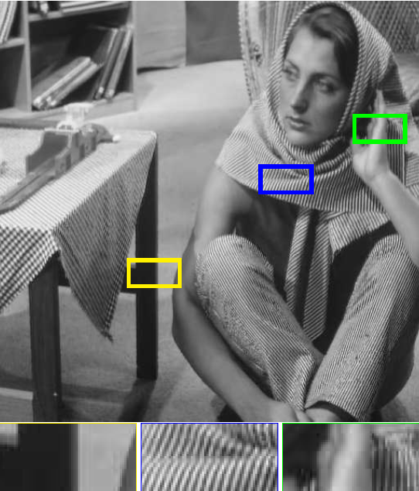
3. Denoising using the Deep Image Prior
Corrupted Image used Image after Deep Image Prior

Slide 18
Dataset and results using Deep image prior
Evaluation is done using denoising approach on the standard dataset which consists of 9 colored images with noise strength of σ = 25.
A PSNR of 29.22 after 1800 optimization steps is achieved.
The score is improved up to 30.43 if we additionally average the restored images obtained in the last iterations (using exponential sliding window). If averaged over two optimization runs, the method further improves up to 31.00 PSNR.
The deep image prior is tested with different network architectures and a 35.05 PSNR is achieved for UNet and a 31.95 PSNR for ResNet.

Slide 19
Further Improvements
05

Slide 20
Improvements
We can try multiple image Augmentation methods which can enhance our results.
We can do pre-training and degradation of images which decreases GPU time and power.
We have used Random networks for training the model. Any optimised Training NeT would provide better results.

Slide 21
References
06
Ulyanov, D., Vedaldi, A. & Lempitsky, V. Deep Image Prior. International Journal of Computer Vision, 2020.
https://doi.org/10.1007/s11263-020-01303-4

Slide 22
Thank You!!

